Slide 1
Installation & Introduction

Slide 2

Introduction to R
R is a language and environment for statistical computing and graphics
R is available as Free Software
It compiles and runs on a wide variety of platforms
R can be easily extended via packages.

Slide 3
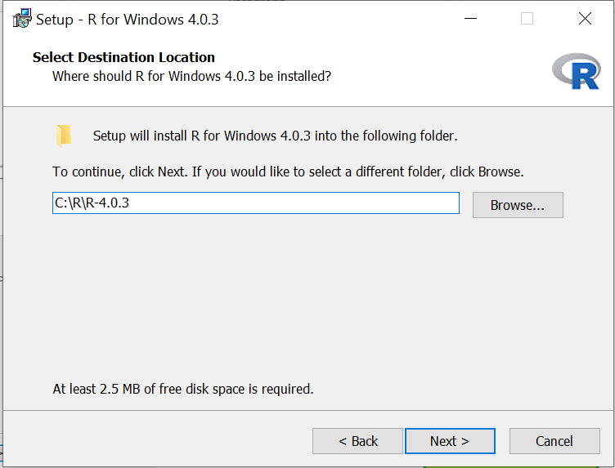
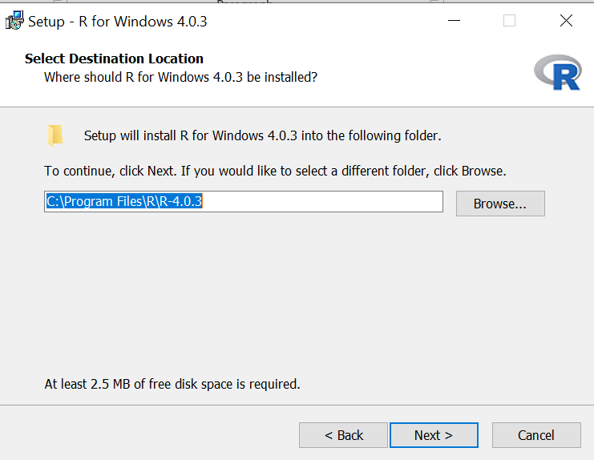
R Installation
http://cran.rstudio.com/
  Download R for Windows
    install R for the first time
C:\Program Files\R\R-?.?.?
C:\R\R-?.?.?

Slide 4
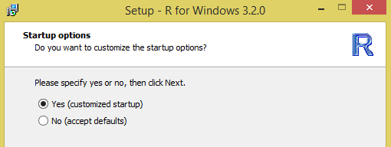
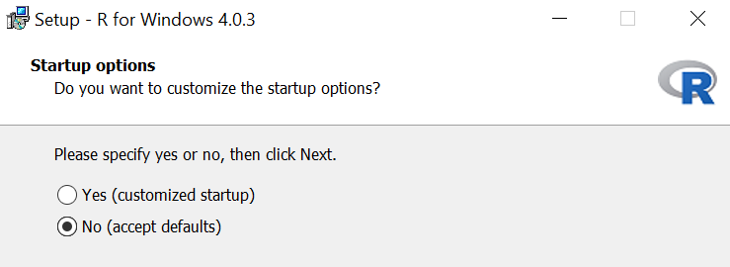
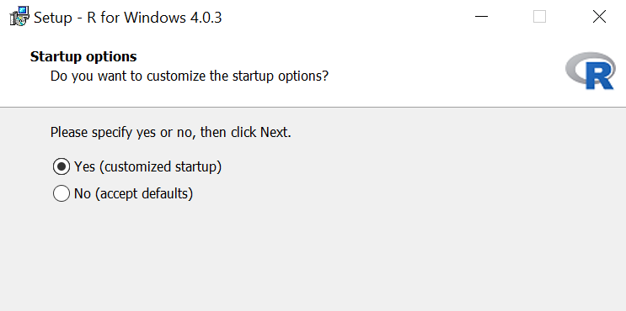
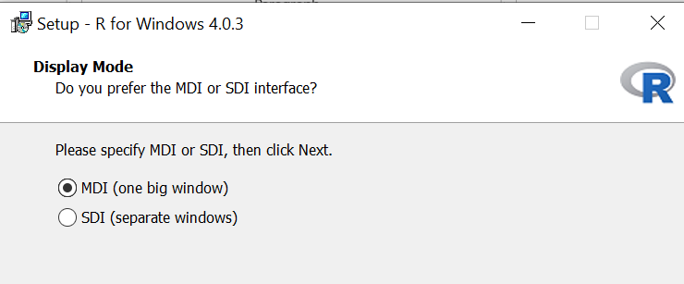
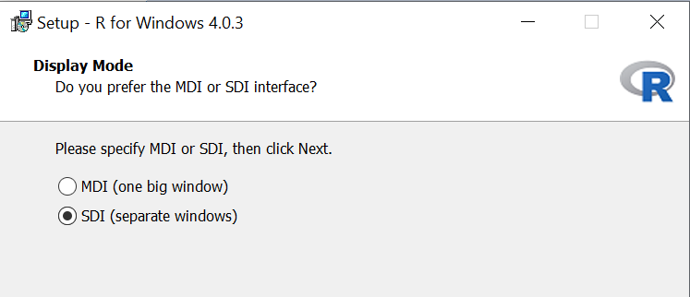
R Installation
No
Yes
MDI
SDI

Slide 5
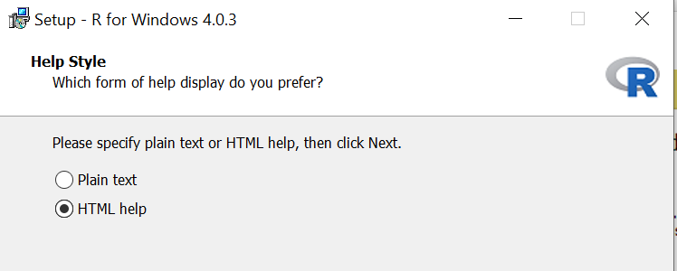
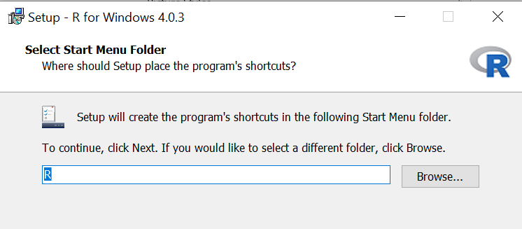
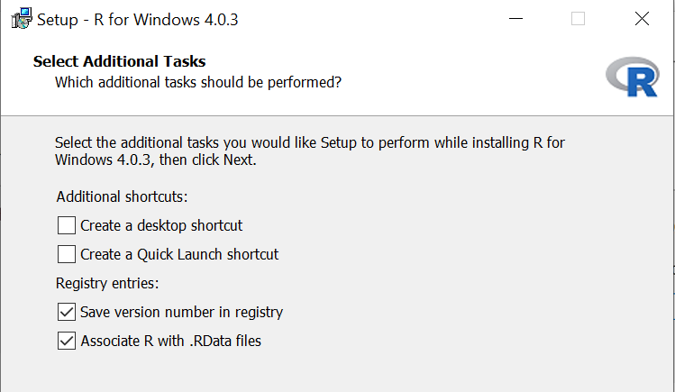
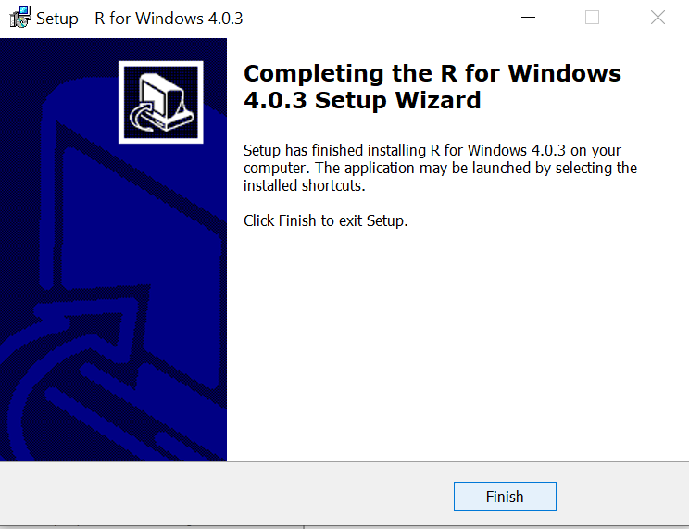

Slide 6

Introduction to RStudio
RStudio is an integrated development environment (IDE) for R
RStudio is available in open source and commercial editions and runs on the desktop or in a browser connected to RStudio Server

Slide 7
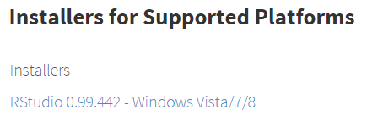
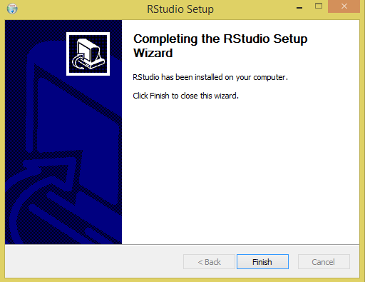
RStudio Installation
http://www.rstudio.com/products/rstudio/download/
Install the latest

Slide 8
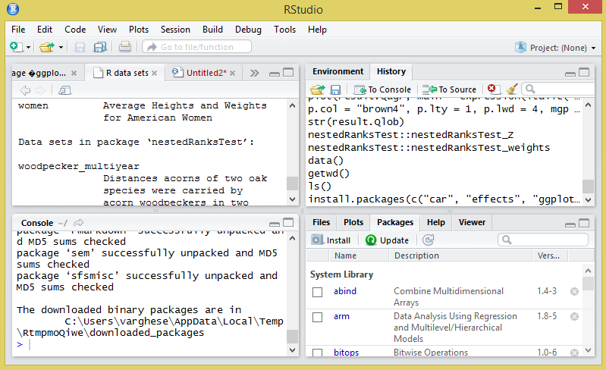
RStudio User Interface
Code Area
Workspace Area
Console Area
Plot, Help and Package Area

Slide 9
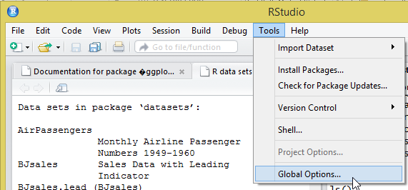
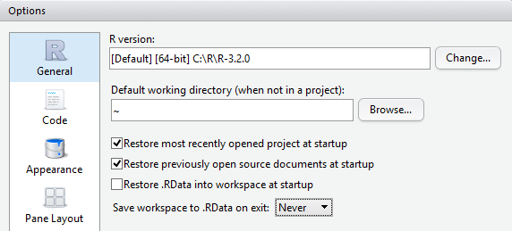
RStudio Setting
Open RStudio >> Tools >> Global Options
Options >> Uncheck Restore .RData into workspace at startup >> Select "Never" for Save workspace to .RData

Slide 10
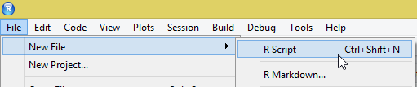
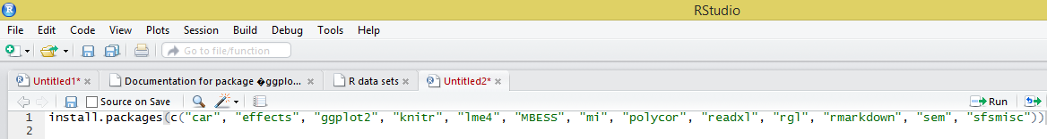
Installing R Packages for the Workshop
File >> New File >> R Script
Copy and paste below code into a new script window (e.g. Untitled2)
  install.packages(c("car", "effects", "ggplot2", "knitr", "lme4", "MBESS", "mi", "polycor", "readxl", "rgl", "rmarkdown", "sem", "sfsmisc"))
Click Run icon
1
4
2
Run = Ctrl + Enter
3

Slide 11
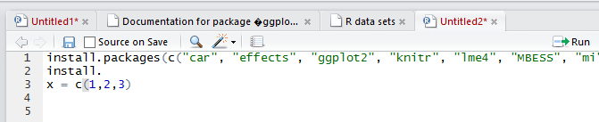
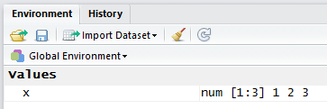
Coding
Code Area
  x = c(1,2,3)
  Click Run
Workspace Area
  Click Environment tab

Slide 12
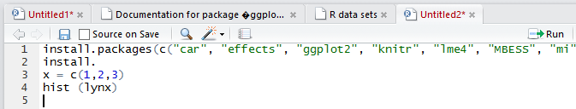
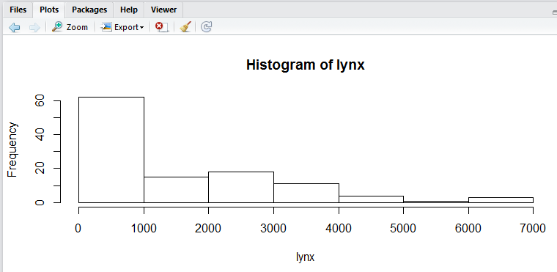
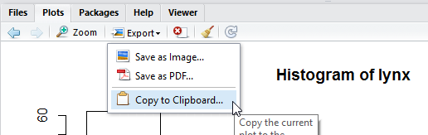
Coding
Code Area
  hist (lynx)
Plot Area
Plot Export Options

Slide 13
Packages
Packages are collections of R functions, data, and compiled code in a well-defined format
Library is the directory where packages are stored
R comes with a standard set of packages
  Others are available for download and installation
  Once installed, they have to be loaded into the session to be used.

Slide 14
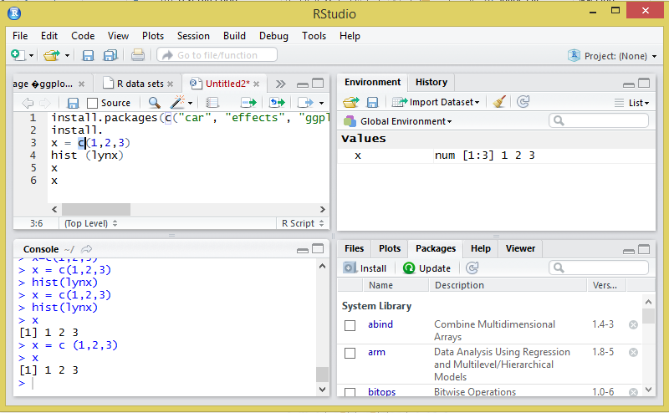
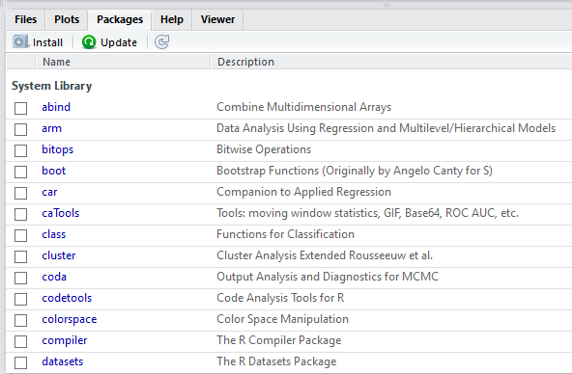
Packages - List

Slide 15
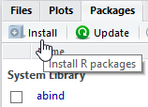
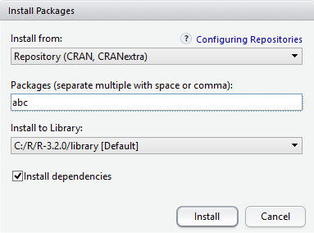
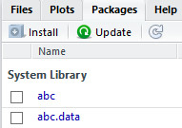
Packages – Downloading & Installation
Code
install.packages("abc")

Slide 16
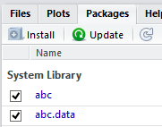
Packages - Loading
Code
library (abc)

Slide 17
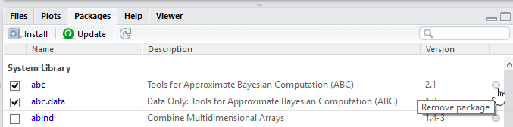
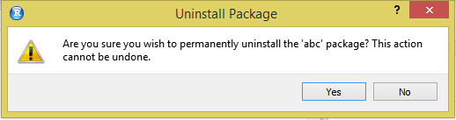
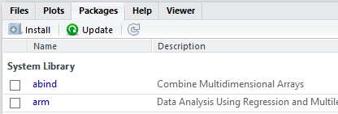
Packages - Removal
Code
remove.packages("abc")

Slide 18
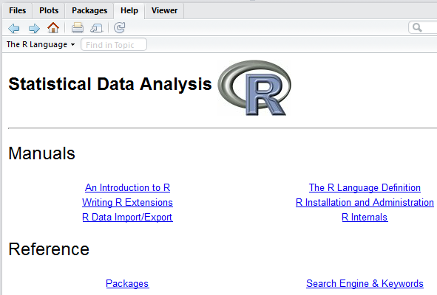

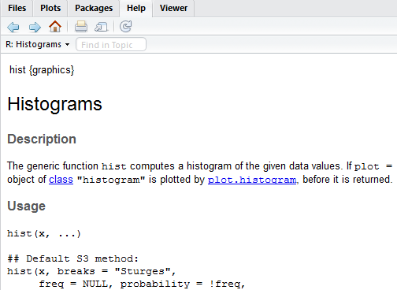
Help
Code
help.start()
Code
?hist

Slide 19
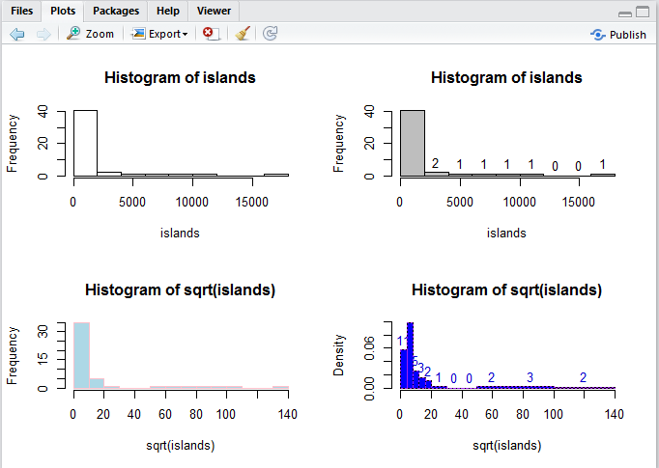
Help
Code
example (hist)
Code
?hist
hist function is available in graphics package

Slide 20
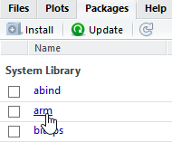
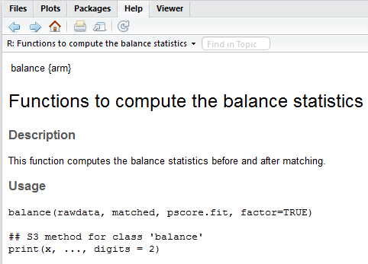
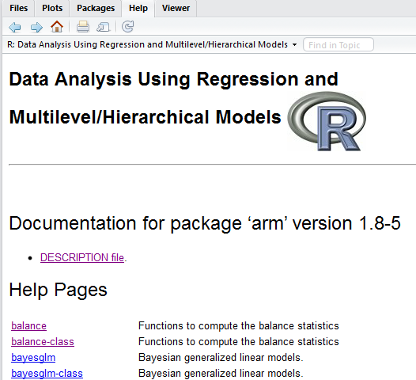
Help – Packages & Functions

